Slide 1
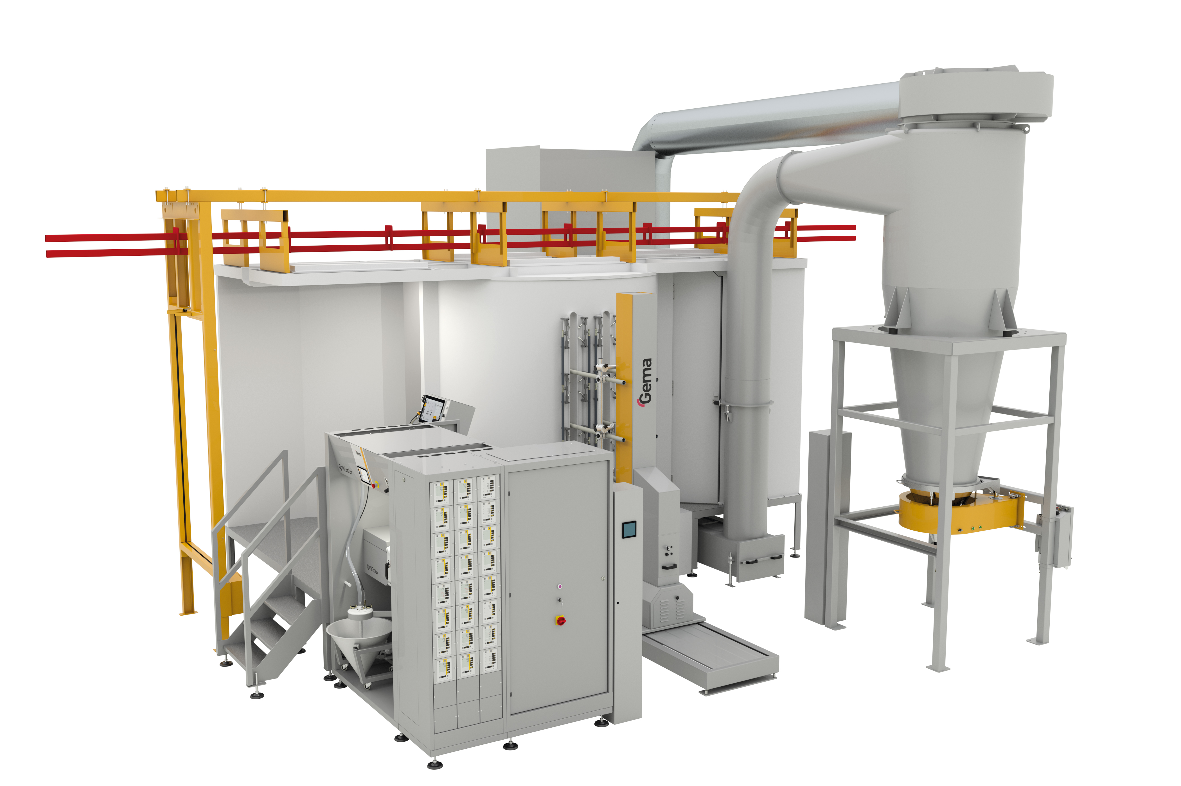
Unique Cylinder design for best performance
The unique MagicCylinder design ensures low powder accumulations and quick cleaning even without entering the booth.
Minimum powder accumulations
Easy
for color change
Smart EquiFlow air distribution

Slide 2
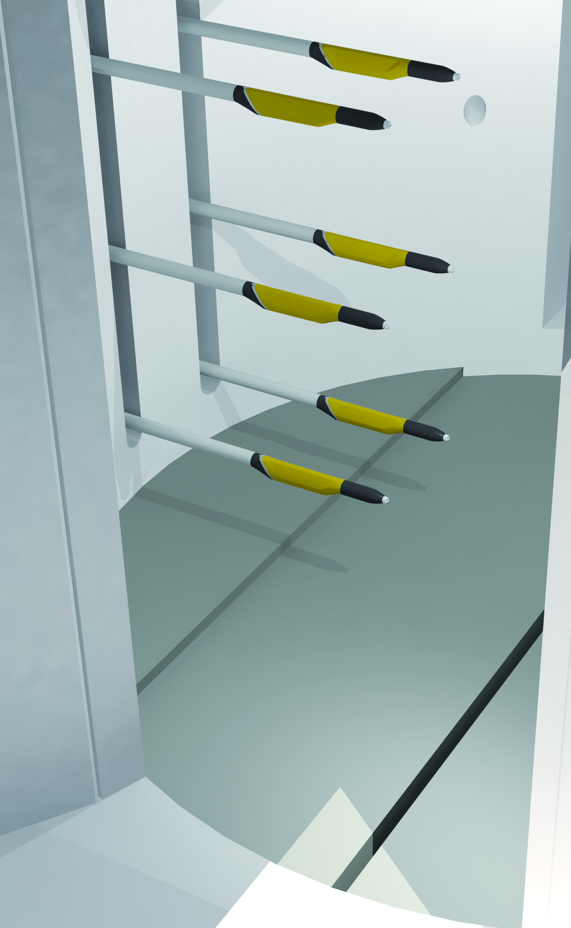
Why a round shaped booth?
A round shape has no corners where powder can accumulate.
With 2,5 m diameter the plastic walls are far apart from the application area and ensure very small powder accumulations.
The booth floor has EquiFlow “H” shaped air extraction slots and is continuously cleaned by air-knives.

Slide 3
Minimum powder accumulations
Thanks to the round shape, the non-conductive materials and the integrated air-knives the Magic Cylinder minimizes powder accumulation in the booth.
The operator’s health is better protected and the risk of ambient contamination is minimized.
The continuous recovery of the powder and the constant mix of fresh and recovery powder result in a better application quality.

Slide 4
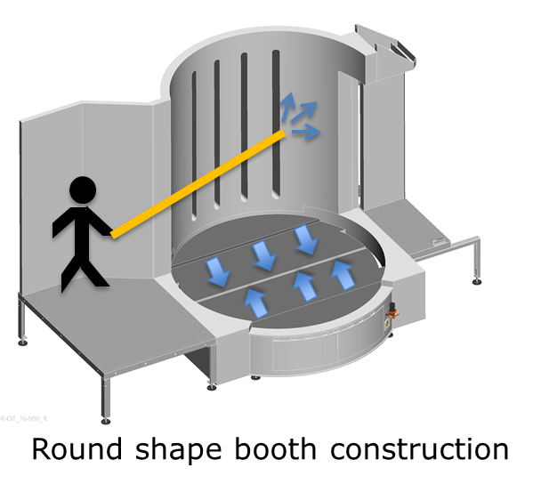
Easy for color change
The booth is so compact that it can be easily cleaned by the operator with an air lance without entering the booth.
A round shape is quicker to clean because it has less inside surface where powder can accumulate.
A round shape is quicker to clean because it has no corners where powder can accumulate.

Slide 5
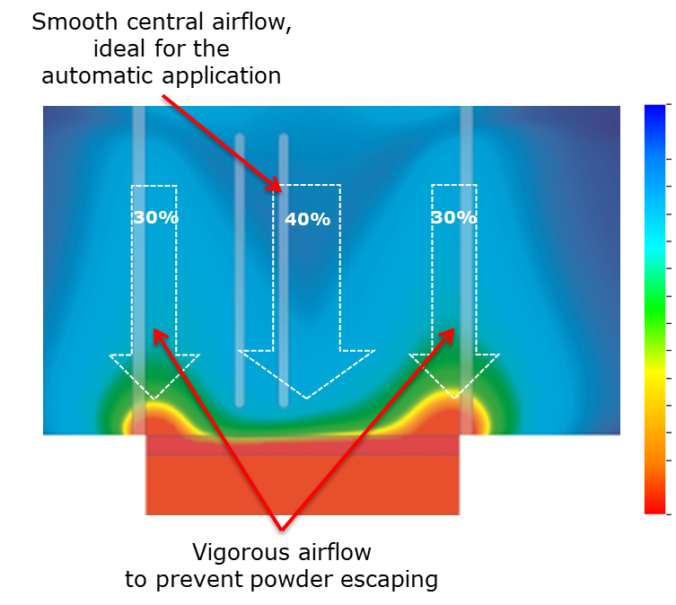
Ideal air distribution
The EquiFlow Technology creates ideal working conditions in each section of the powder coating booth
A smooth and homogeneous airflow in the central area ensures ideal powder application conditions for automatic coating.
A vigorous airflow at the entrance / exit avoids powder escaping the booth and creates optimal working conditions for the touch-up operators.

